Slide 1

Java Date Time API

Slide 2
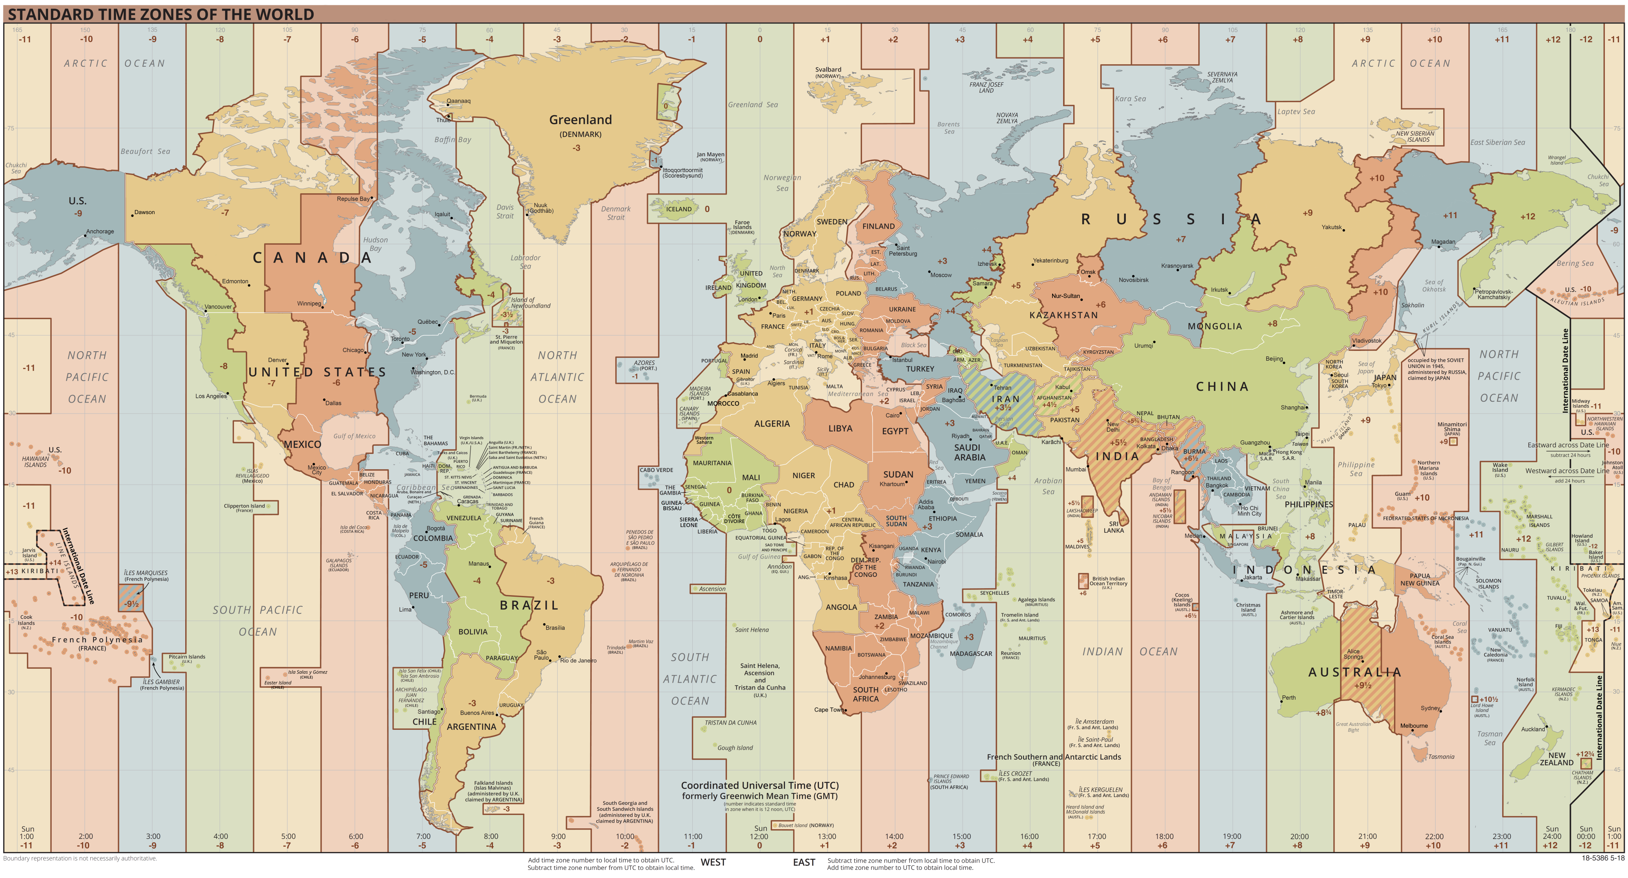
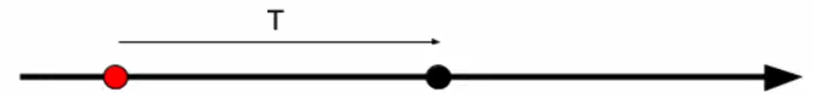
GMT (Greenwich Mean Time) – the averaged solar time of the zero meridian. Calculated astronomically by the position of the Earth relative to other objects. GMT is also directly used as a time zone in some countries.
UTC (Coordinated Universal Time) – time standard introduced to replace GMT and is calculated using atomic clocks. It is used only as a reference for an offset, not a time zone.
Unix time (POSIX time) - is a system for describing moments in time which is defined as the number of seconds elapsed since midnight (00:00:00 UTC) on January 1, 1970.

Slide 3
Old Date Time API
(before java 8)

Slide 4
java.util.Calendar is used for various operations with time, such as reading/setting/modifying individual calendar fields (year, month, day, hours, minutes, seconds, etc.).
java.utl.Date is essentially identical to a simple numeric long - the Unix time value in milliseconds.
java.sql.Date - subclass java.util.Date to work with the type of DATE in the database.
java.sql.Time - subclass java.util.Date to work with the type of TIME in the database.
java.sql.Timestamp - subclass java.util.Date with nanosecond accuracy to work with the type TIMESTAMP in the database.
java.text.DateFormat is used for converting timestamps to and from an axis point.
java.util.TimeZone contains information about the time zone is represented by java.

Slide 5
New Date Time API
(java 8 and beyond)

Slide 6
java.time.Clock
java.time.Clock is the core of the new API.
The factory methods of java.time.Clock:
systemDefaultZone - creates the system clock in the default time zone.
systemUTC - creates a system clock in the UTC time zone.
system - creates a system clock in the specified time zone.
fixed - creates a constant time clock, i.e. the clock does not go but stands still.
offset - creates a proxy over the specified clock that shifts the time by a specified amount.
tickSeconds - creates a system clock in the specified time zone whose value is rounded to whole seconds.
tickMinutes - creates a system clock in the specified time zone whose value is rounded to whole minutes.
tick - creates a proxy over the specified clock that rounds the time values to the specified period.
withZone - creates a copy of the current clock in another time zone.

Slide 7
java.time.Instant - created to replace java.util.Date, but immutable, with nanosecond precision and correct name. It stores Unix time as two fields: long with the number of seconds, and int with the number of nanoseconds within the current second.
java.time.LocalTime is a tuple (hour, minute, second, nanosecond).
java.time.LocalDate is a tuple (year, month, day month).
java.time.LocalDateTime both tuples together.

Slide 8
Working with the time zone and offset
java.time.ZoneId specifies a time zone. It's two subclasses java.time.ZoneRegion and java.time.ZoneOffset implements two types of time zones: a time zone based on geography and a time zone based on a simple offset from UTC or GMT.
java.time.ZonedDateTime - the analog of java.util.Calendar. This is the most powerful class with full information about the time context, it includes a time zone, so this class does all shift operations correctly.
java.time.OffsetTime is a LocalTime + ZoneOffset.
java.time.OffsetDateTime is LocalDateTime + ZoneOffset.

Slide 9
Other useful classes
java.time.Period - describes the calendar duration as a tuple (year, month, day).
java.time.Duration - describes the exact duration as an integer number of seconds and fractions of the current second as nanoseconds.
java.time.format.DateTimeFormatter - describes the formatting and parsing settings.
java.time.temporal.TemporalAdjuster - is a functional interface which allows to define custom logic for date and time processing, has many predefined implementations in the TemporalAdjusters class.

Slide 10
Summary table
Old API | New API (JDK 8+) | Notes (new)
java.util.Calendar | java.time.ZonedDateTime | The most powerful class contains all information about time context.
java.util.Date | java.time.Instant | represents a point on the timeline (without time zone).
java.sql.Date | java.time.LocalDate | Represents only date, without time and time zone.
java.sql.Time | java.time.LocalTime | Represents only time, without date and time zone.
java.sql.TimeStamp | java.time.LocalDateTime | Represents date and time without a time zone.
 | java.time.OffsetTime | represents only time and time zone. LocalTime + ZoneOffset
 | java.time.OffsetDateTime | Represents date, time, and time zone. LocalDateTime + ZoneOffset
 | java.time.Period | Represents calendar duration as the cortege of year, month, and day.
 | java.time.Duration | Description of the exact duration as an integer number of seconds and fractions of the current second as nanoseconds.
java.text.DateFormat | java.time.format.DateTimeFormatter | Used for formatting and parsing.

Slide 11
Demo time

Slide 12
Disadvantages of the new API
The new API does not control the validity of operations in compile - time. Many problems with lack of time zone will only appear at runtime.
The problem of leap second accounting has not been solved in any way. The new API relies on an external second-hand backward translation.

Slide 13
Conclusion
All classes in the new API are immutable and thread-safe.
The new API has a time precision of 1 nanosecond, while the old API has a precision of 1 millisecond.
In the old API, many actions can be performed without specifying a time zone. In this case, the default time zone is taken, which is not always required and can lead to errors.
In the new API, all actions that need to specify the time zone, require it explicitly. The "default" time zone does not exist.
In the new API month numbers start with 1, and there is also a new enumeration java.time.Month.
All classes from the new API are located in the package “java.time”.

Slide 14
Links
https://docs.oracle.com/en/java/javase/17/docs/api/java.base/java/time/package-summary.html
https://github.com/eugenp/tutorials/tree/master/core-java-modules/core-java-8-datetime
https://en.wikipedia.org/wiki/Coordinated_Universal_Time
https://en.wikipedia.org/wiki/Unix_time

Slide 15
QA
Do you have any questions?

